Slide 1
Who Should I Cite?
Learning Literature Search Models from Citation Behavior
CIKM’10
Advisor：Jia Ling, Koh
Speaker：SHENG HONG, CHUNG

Slide 2
Outline
Introduction
Features
Similar terms
Cited information
Regency
Cited using similar terms
Similar topics
Social habits
Experiment
Conclusion

Slide 3
Introduction
Motivation
Researcher
Project idea
hard to determine prior research has been done and what prior research is more relevant
The result from search engine is not good enough
Solution
Add more features in retrieval model

Slide 4
Framework of the system
Input
Output
query( topic )
System
reference list
abstract
d₁
d₂
d₃
.
.
.
.

Slide 5
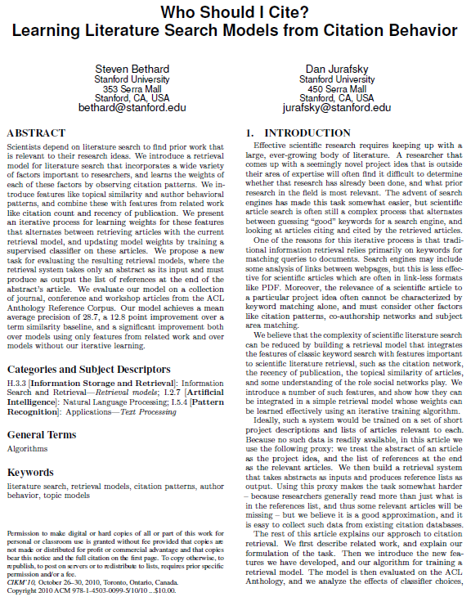
Pattern from article

Slide 6
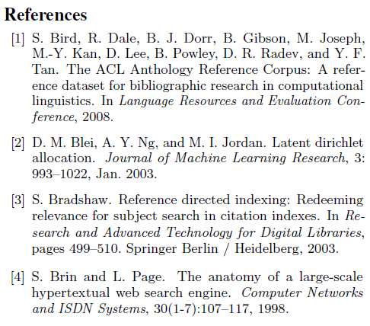
Pattern from article

Slide 7
Example
Corpus
D₁
D₂
D₃
D₄
D₅
Author: a₁ a₂
Venue: CIKM
Context:
{t₁:3,t₂:2,t₃:1}
total: 6
D₂
D₃
D₄
Author: a₁ a₃
Venue: CIKM
Context:
{t₁:2,t₂:2}
total:4
D₁
D₅
Author: a₁ a₂ a₃
Venue: CIKM
Context:
{t₁:3,t₃:1}
total:4
D₁
D₂
D₄
Author: a₂ a₃
Venue: SIGIR
Context:
{t₂:4,t₄:2}
total:6
D₂
D₃
D₅
Author: a₄
Venue: SIGIR
Context:
{t₄:3,t₅:2}
total:5
D₁
D₂

Slide 8
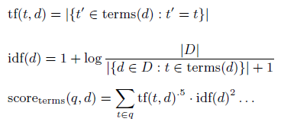
Similar terms
Corpus
query( topic )
D₁
D₂
D₃
D₄
D₅
.
.
.
.
abstract
TF-IDF score : topic terms and abstract terms match against document contexts
Score_{terms}(q,D1)
Score_{terms}(q,D2)
Score_{terms}(q,D3)
….

Slide 9
Cited information
D₁
D₂
D₃
D₄
D₅
Author: a₁ a₂
Venue: CIKM
Context:
{t₁:3,t₂:2,t₃:1}
total: 6
D₂
D₃
D₄
Author: a₁ a₃
Venue: CIKM
Context:
{t₁:2,t₂:2}
total:4
D₁
D₅
Author: a₁ a₂ a₃
Venue: CIKM
Context:
{t₁:3,t₃:1}
total:4
D₁
D₂
D₄
Author: a₂ a₃
Venue: SIGIR
Context:
{t₂:4,t₄:2}
total:6
D₂
D₃
D₅
Author: a₄
Venue: SIGIR
Context:
{t₄:3,t₅:2}
total:5
D₁
D₂
According to the feature from corpus :
cite(D₁) = {D₂D₃D₅}
|cite(D₁) |= 3 = score_{citation-count}(q,D₁)
cite(D₂) = {D₁D₃D₄D₅}
|cite(D₂) |= 4 = score_{citation-count}(q,D₂)
cite(D₃) = {D₁D₄}
|cite(D₃) |= 2 = score_{citation-count}(q,D₃)
cite(D₄) = {D₁D₃}
|cite(D₄) |= 2 = score_{citation-count}(q,D₄)
cite(D₅) = {D₂D₄}
|cite(D₅) |= 2 = score_{citation-count}(q,D₅)

Slide 10
D₁
D₂
D₃
D₄
D₅
Author: a₁ a₂
Venue: CIKM
Context:
{t₁:3,t₂:2,t₃:1}
total: 6
D₂
D₃
D₄
Author: a₁ a₃
Venue: CIKM
Context:
{t₁:2,t₂:2}
total:4
D₁
D₅
Author: a₁ a₂ a₃
Venue: CIKM
Context:
{t₁:3,t₃:1}
total:4
D₁
D₂
D₄
Author: a₂ a₃
Venue: SIGIR
Context:
{t₂:4,t₄:2}
total:6
D₂
D₃
D₅
Author: a₄
Venue: SIGIR
Context:
{t₄:3,t₅:2}
total:5
D₁
D₂
D₃
D₂
D₁
D₄
D₅

Slide 11
D₃
D₂
D₁
D₄
D₅
Score_{pagerank}(q,D₁) = 0.15/5 +
0.85 * (Score_{pagerank}(q,D₂) /4 + Score_{pagerank}(q,D₃) /2+ Score_{pagerank}(q,D₅) /2)

Slide 12
D₁
D₂
D₃
D₄
D₅
Author: a₁ a₂
Venue: CIKM
Context:
{t₁:3,t₂:2,t₃:1}
total: 6
D₂
D₃
D₄
Author: a₁ a₃
Venue: CIKM
Context:
{t₁:2,t₂:2}
total:4
D₁
D₅
Author: a₁ a₂ a₃
Venue: CIKM
Context:
{t₁:3,t₃:1}
total:4
D₁
D₂
D₄
Author: a₂ a₃
Venue: SIGIR
Context:
{t₂:4,t₄:2}
total:6
D₂
D₃
D₅
Author: a₄
Venue: SIGIR
Context:
{t₄:3,t₅:2}
total:5
D₁
D₂
D₂
D₃
cite(D₁) = {D₂D₃D₅}
score_{venue-citation-count}(q,D₁) = 4 + 2 =6
cite(D₂) = {D₁D₃D₄D₅}
a₁:{ D₁,D₂,D₃ }
score_{author-citation-count}(q,D₁)
= max{9,7} = 9
cite(D₃) = {D₁D₄}
a₂:{ D₁,D₃,D₄ }
cite(D₄) = {D₁D₃}
cite(D₅) = {D₂D₄}

Slide 13
D₁
D₂
D₃
D₄
D₅
Author: a₁ a₂
Venue: CIKM
Context:
{t₁:3,t₂:2,t₃:1}
total: 6
D₂
D₃
D₄
Author: a₁ a₃
Venue: CIKM
Context:
{t₁:2,t₂:2}
total:4
D₁
D₅
Author: a₁ a₂ a₃
Venue: CIKM
Context:
{t₁:3,t₃:1}
total:4
D₁
D₂
D₄
Author: a₂ a₃
Venue: SIGIR
Context:
{t₂:4,t₄:2}
total:6
D₂
D₃
D₅
Author: a₄
Venue: SIGIR
Context:
{t₄:3,t₅:2}
total:5
D₁
D₂
An author has published h papers
each of which has been cited by others at least h times
cite(D₁) = {D₂D₃D₅}
cite(D₂) = {D₁D₃D₄D₅}
h = 3
cite(D₃) = {D₁D₄}
a₁:{ D₁,D₂,D₃ }
score_{author-h-index}(q,D₁)
= max{7,3} = 7
cite(D₄) = {D₁D₃}
a₂:{ D₁,D₃,D₄ }
cite(D₅) = {D₂D₄}
13

Slide 14
D₁
D₂
D₃
D₄
D₅
Author: a₁ a₂
Venue: CIKM
Context:
{t₁:3,t₂:2,t₃:1}
total: 6
Year:2007
D₂
D₃
D₄
Author: a₁ a₃
Venue: CIKM
Context:
{t₁:2,t₂:2}
total:4
Year:2008
D₁
D₅
Author: a₁ a₂ a₃
Venue: CIKM
Context:
{t₁:3,t₃:1}
total:4
Year:1988
D₁
D₂
D₄
Author: a₂ a₃
Venue: SIGIR
Context:
{t₂:4,t₄:2}
total:6
Year:2003
D₂
D₃
D₅
Author: a₄
Venue: SIGIR
Context:
{t₄:3,t₅:2}
total:5
Year:2002
D₁
D₂
Year:2009
score_{age}(q,D₁) = -(2009-2007) = -2
query( topic )
score_{age}(q,D₃) = -(2009-1988) = -21

Slide 15
Cited using similar terms
D₁
D₂
D₃
D₄
D₅
Author: a₁ a₂
Venue: CIKM
Context:
{t₁:3,t₂:2,t₃:1}
total: 6
Year:2007
D₂
D₃
D₄
Author: a₁ a₃
Venue: CIKM
Context:
{t₁:2,t₂:2}
total:4
Year:2008
D₁
D₅
Author: a₁ a₂ a₃
Venue: CIKM
Context:
{t₁:3,t₃:1}
total:4
Year:1988
D₁
D₂
D₄
Author: a₂ a₃
Venue: SIGIR
Context:
{t₂:4,t₄:2}
total:6
Year:2003
D₂
D₃
D₅
Author: a₄
Venue: SIGIR
Context:
{t₄:3,t₅:2}
total:5
Year:2002
D₁
D₂
TF-IDF + cited information
cite(D₁) = {D₂D₃D₅}
score_{term-citing}(q,D₁)
= score_{terms}(q,concat(term(D₂),term(D₃),term(D₅)))
cite(D₂) = {D₁D₃D₄D₅}
cite(D₃) = {D₁D₄}
cite(D₄) = {D₁D₃}
cite(D₅) = {D₂D₄}

Slide 16
avoid noise and get accurate information
Use pmi to determine important words
D₁
D₂
D₃
D₄
D₅
Author: a₁ a₂
Venue: CIKM
Context:
{t₁:3,t₂:2,t₃:1}
total: 6
Year:2007
D₂
D₃
D₄
Author: a₁ a₃
Venue: CIKM
Context:
{t₁:2,t₂:2}
total:4
Year:2008
D₁
D₅
Author: a₁ a₂ a₃
Venue: CIKM
Context:
{t₁:3,t₃:1}
total:4
Year:1988
D₁
D₂
D₄
Author: a₂ a₃
Venue: SIGIR
Context:
{t₂:4,t₄:2}
total:6
Year:2003
D₂
D₃
D₅
Author: a₄
Venue: SIGIR
Context:
{t₄:3,t₅:2}
total:5
Year:2002
D₁
D₂
cite(D₁) = {D₂D₃D₅}
pmi(t₁,D₁) = log (p_{termciting}(t₁,D₁) / p_{term}(t₁)p_{citing}(D₁))
cite(D₂) = {D₁D₃D₄D₅}
p_{term}(t₁) = (3+2+3)/(6+4+4+6+5 ) = 8/25
cite(D₃) = {D₁D₄}
p_{citing}(D₁) = 3/(3+4+2+2+2)= 3/13
cite(D₄) = {D₁D₃}
p_{termciting}(t₁,D₁) = (2+3)/(13+21+12+10+10) = 5/66
cite(D₅) = {D₂D₄}

Slide 17
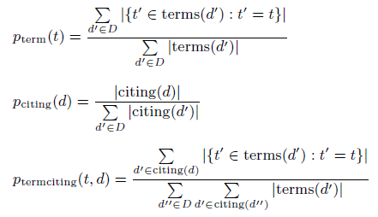
Cited using similar terms
Purpose : get valuable terms from cited documents, then calculate TF-IDF
form words with high pmi scores in pseudo-document, call text_{pmi}
Documents that are cited at least 5 times and terms that occur at least 2 times

Slide 18
Similar topics
topics(d)={p_{topics}(1,d),p_{topics}(2,d),p_{topics}(3,d)}
topics(D₁)={1/4,1/4,1/2}
topics(q) = {1/3,1/3,1/3}
score_{topics}(q,D₁) = cos(topics(q),topics(D₁))
score_{topic-entropy}(q,D₁) = -(1/4*log1/4 +1/4*log1/4+1/2*log1/2)

Slide 19
Similar topics
Purpose : compress corpus into 100 words, get accurate concept, then calculate scores
Purpose : use cited information

Slide 20
Similar topics
Purpose : focus on one concept
Purpose : calculate the entropy

Slide 21
Social Habits
D₁
D₂
D₃
D₄
D₅
Author: a₁ a₂
Venue: CIKM
Context:
{t₁:3,t₂:2,t₃:1}
total: 6
Year:2007
D₂
D₃
D₄
Author: a₁ a₃
Venue: CIKM
Context:
{t₁:2,t₂:2}
total:4
Year:2008
D₁
D₅
Author: a₁ a₂ a₃
Venue: CIKM
Context:
{t₁:3,t₃:1}
total:4
Year:1988
D₁
D₂
D₄
Author: a₂ a₃
Venue: SIGIR
Context:
{t₂:4,t₄:2}
total:6
Year:2003
D₂
D₃
D₅
Author: a₄
Venue: SIGIR
Context:
{t₄:3,t₅:2}
total:5
Year:2002
D₁
D₂
Authors like to cite the paper written by him
query
score_{authors}(q,D1) = score_{terms}(authors(q),authors(D₁))
= tf(a₁)*idf(a₁)+tf(a₂)+idf(a₂)
= 1*(1+log(5/(3+1))) + 1*(1+log(5/(2+1)))
Author: a₁ a₂

Slide 22
Social Habits
D₁
D₂
D₃
D₄
D₅
Author: a₁ a₂
Venue: CIKM
Context:
{t₁:3,t₂:2,t₃:1}
total: 6
Year:2007
D₂
D₃
D₄
Author: a₁ a₃
Venue: CIKM
Context:
{t₁:2,t₂:2}
total:4
Year:2008
D₁
D₅
Author: a₁ a₂ a₃
Venue: CIKM
Context:
{t₁:3,t₃:1}
total:4
Year:1988
D₁
D₂
D₄
Author: a₂ a₃
Venue: SIGIR
Context:
{t₂:4,t₄:2}
total:6
Year:2003
D₂
D₃
D₅
Author: a₄
Venue: SIGIR
Context:
{t₄:3,t₅:2}
total:5
Year:2002
D₁
D₂
If author cited the document previously
query
cite(D₁) = {D₂D₃D₅}
Author: a₁ a₂
score_{author-cited-article}(q,D₁) = score_{terms}(authors(q) ,concat(authors(D₂),authors(D₃),authors(D₅)))
= 2*1+log(5/(2+1))+1*(1+log(5/(1+1)))
cite(D₂) = {D₁D₃D₄D₅}
cite(D₃) = {D₁D₄}
cite(D₄) = {D₁D₃}
cite(D₅) = {D₂D₄}

Slide 23
Social Habits
score_{author-cited-article}(q,D₁)
Don’t care D₁ author
D₁
cite(D₁)={D₂,D₃,D₅}
q
D
D’
cite
score_{author-cited-author}(q,D₁)
Care D₁ author
D₁D₂D₃D₄
cite(D₁),cite(D₂),cite(D₃),cite(D₄)
q
D
cite
D’

Slide 24
Social Habits
score_{author-cited-venue}(q,D₁)
fix D₁ venue
D₁D₂D₃
cite(D₁),cite(D₂),cite(D₃)
q
D
D’
cite

Slide 25
Social Habits
Score_{authors-coauthored}(q,D₁)
D₁D₂D₃D₄
cite(D₁),cite(D₂),cite(D₃),cite(D₄)
q
D
cite
D’
{a₁,a₂}
{a₃,a₄}

Slide 26
Weighted sum
Combined all features by weighted sum
Compress scale

Slide 27
Experiment
Precision
Average precision
Mean average precision

Slide 28
Precision / Recall
Precision = Relevant Documents Retrieved / Total Retrieved Documents
Recall = Relevant Documents Retrieved / Total Relevant Documents
Example :
Dataset : 10000 data
500 data related to dining food
User gives a query “dining food ”, system retrieves 4000 data, 400 data related to dining food
Precision = 400/4000
Recall = 400/500

Slide 29
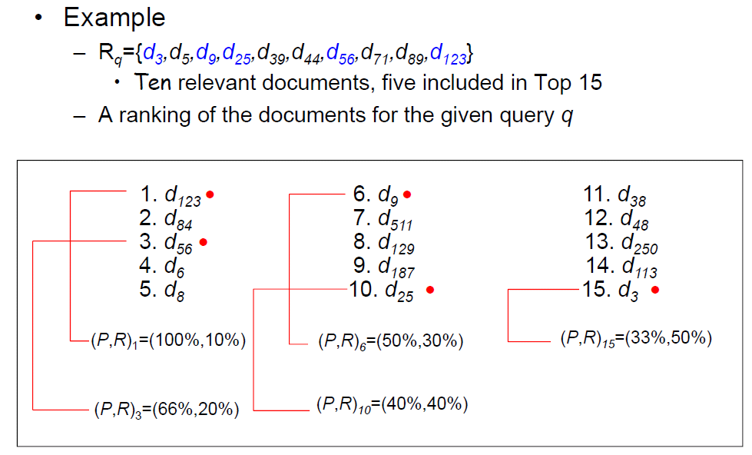

Slide 31
Q₁
Retrieval documents
System
Average precision
.
.
.
.
.
.
Q₁₆
Retrieval documents
System
Average precision
MAP = (Q₁+Q₂+…+Q₁₆) / 16

Slide 32
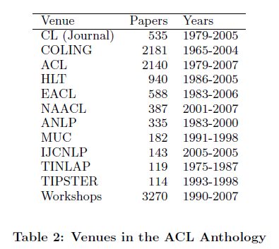
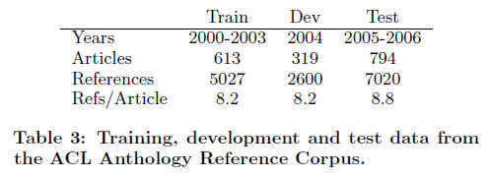
Experiment

Slide 33
Experiment
Who Should I Cite?
topic
+
abstract
reference list
System
retrieve
D₁
D₅
D₃
D₄
reference
D₁
D₂
D₃
D₄
MAP

Slide 34
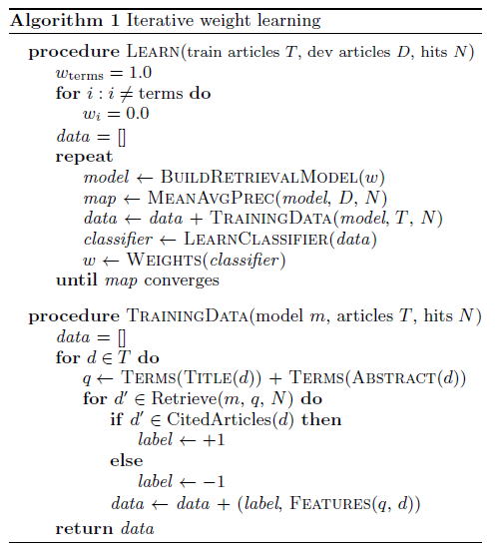
score(q,d)
= w₁*f₁+w₂*f₂+…+w₁₉*f₁₉
w₁ = 1, w₂~w₁₉=0
score(q,d) = w₁*f₁
D₁
D₂
D₃
.
.
Model
+
weight
Retrieve
documents
Calculate
MAP
Development
data
D₁
D₅
D₃
.
.

Slide 35
data = []
put q into model m( w₁=1, else = 0)
Get retrieval documents d’
Training data d
ref
S
If d’ ∈ S, label = 1
Else label = -1
data update,
using classifier to adjust weights
Iterative procedure

Slide 36
Experiment

Slide 37
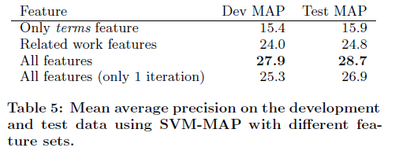
Experiment
Related work features :
terms, citation-count, pagerank, age, term-citing, authors

Slide 38
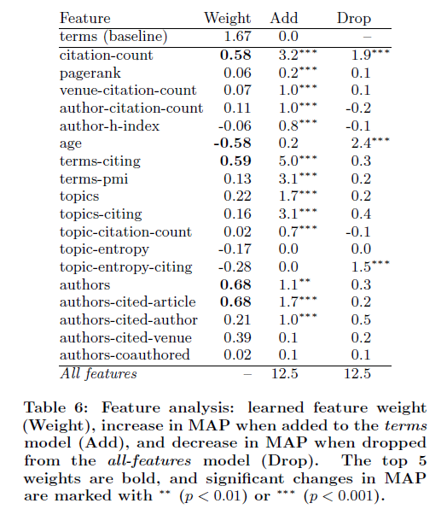
Experiment

Slide 39
Conclusion
Present a model for scientific article retrieval that introduces new features and new learning algorithm.
Show that the weights for these features can be more efficiently learned by an iterative procedure.

